Slide 1

Data Analysis
Made by:
Irvan Ilahibaks- 8081847
Timon Baris - 2173182
Waling van Dongen - 1176226
TA:
Sita Newer
Vak
Data Analytics
15 - 9 - 2024

Slide 2
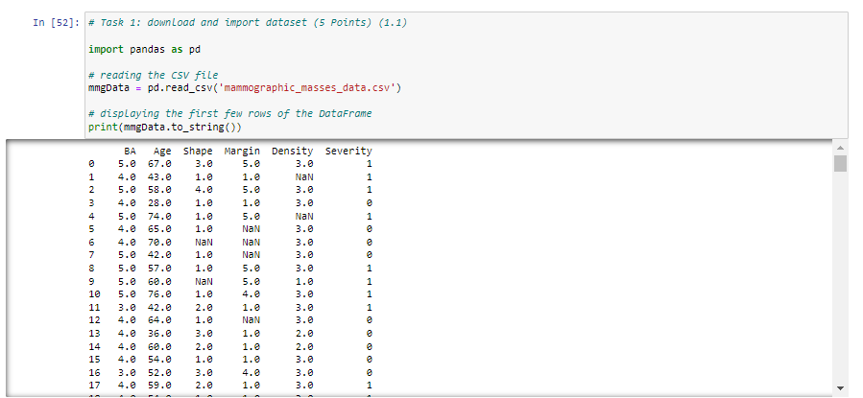
Raw Data

Slide 3
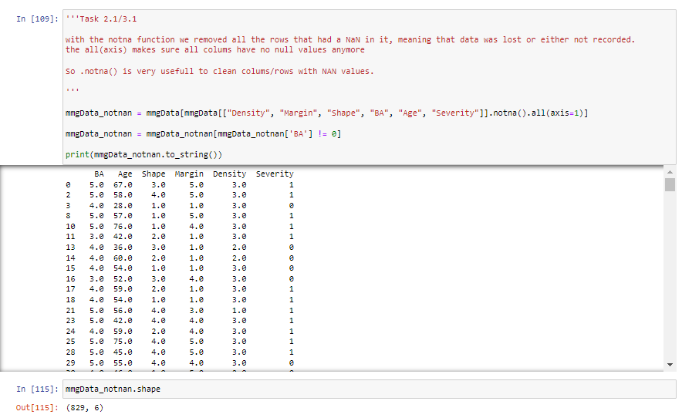
Clean Data

Slide 4
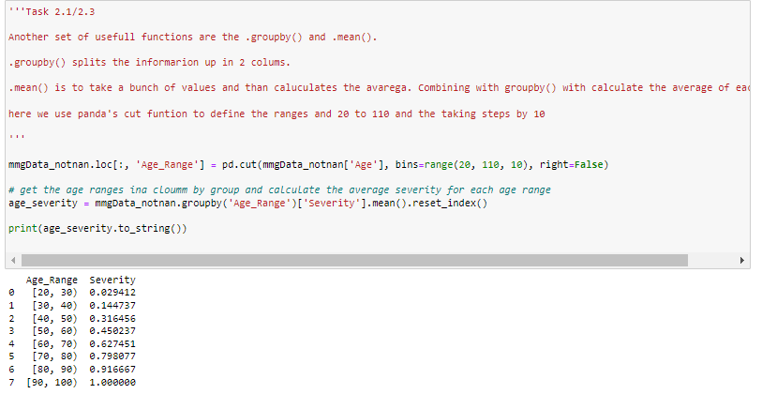
Task 2: Get dataset on screen
Functions essential to render summary statistics, mean(), count(), groupby()

Slide 5
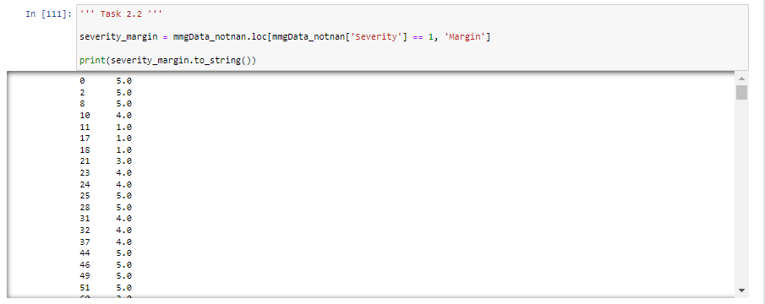
Task 2: Get dataset on screen
For Task 2.2 we used the 'loc' function to show the margin attribute of every instance of the data where the severity is 1.

Slide 6
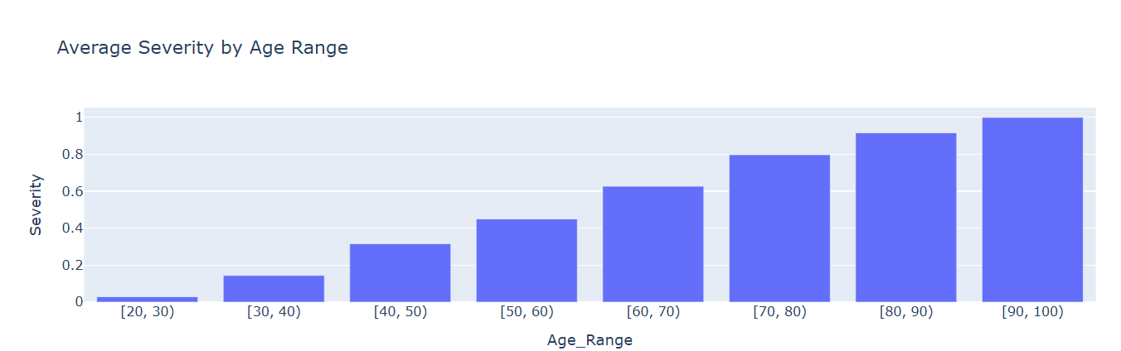
Task 2: Get dataset on screen
For Task 2.3

Slide 7
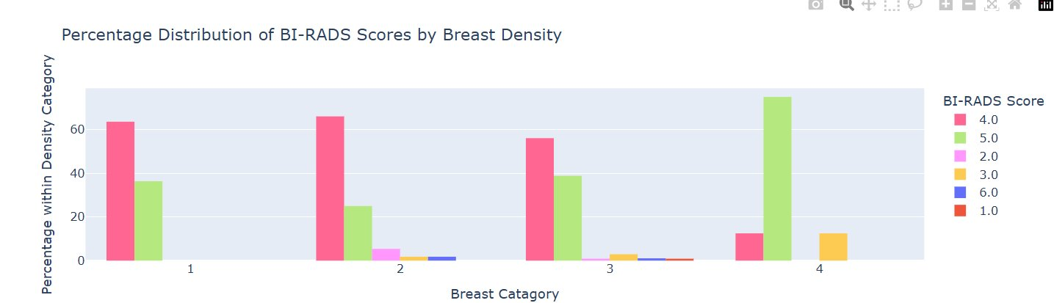
Task 2: Get dataset on screen

Slide 8
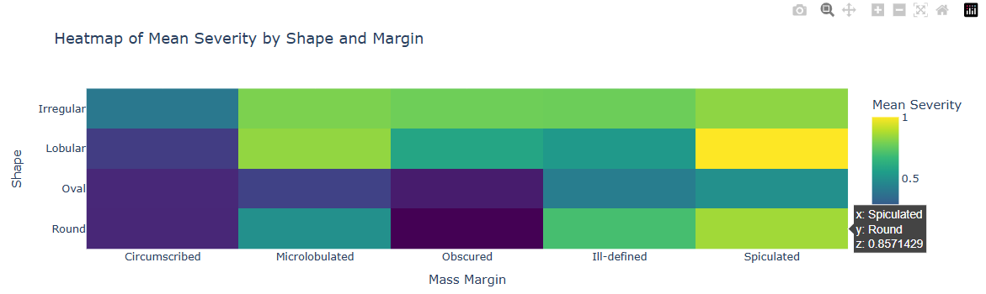
Task 2: Get dataset on screen

Slide 9
Task 3: Preprocessing
Firstly we cleaned the dataset.
We rendered the cleaned and uncleaned datasets

Slide 10
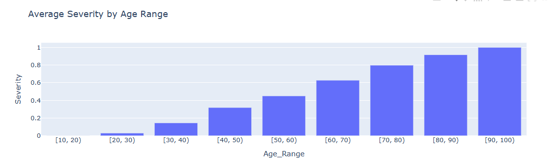
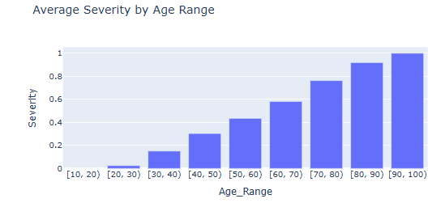
Task 3: Clean vs Raw

Slide 11

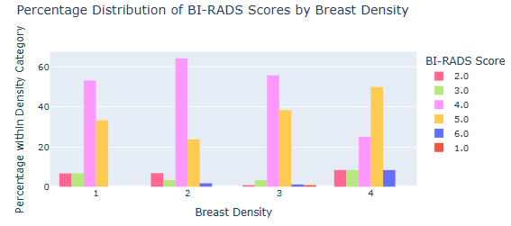
Task 3: Clean vs Raw

Slide 12
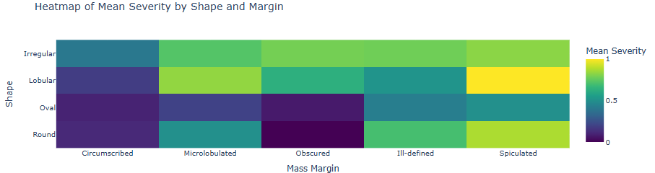
Task 3: Clean vs Raw

Slide 13
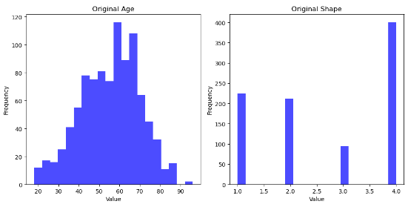
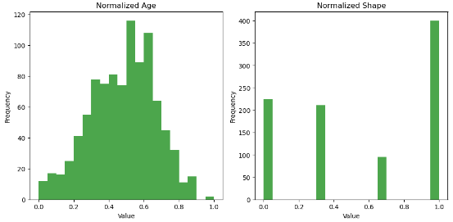
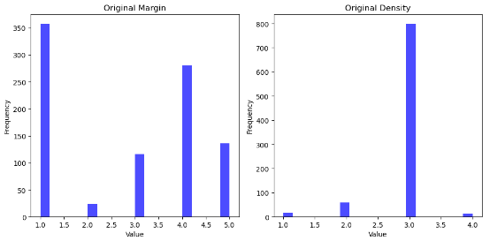
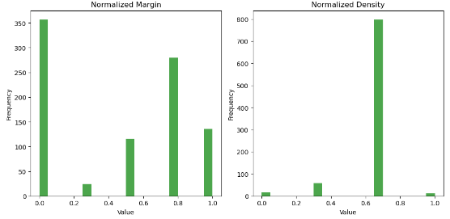
Task 3: Preprocessing
Secondly we coded a normalization algorithm.
Normalized is better for LLM
Unnormalized dataset
Normalized Dataset

Slide 14
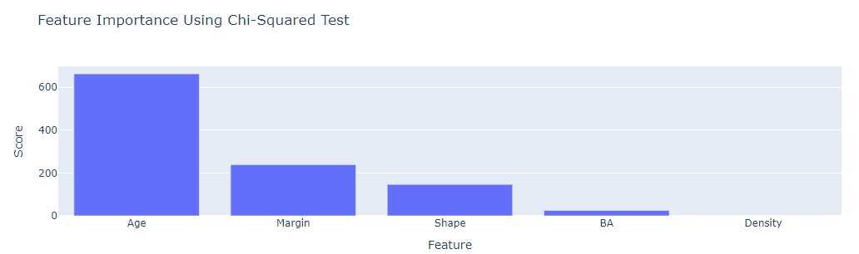
Task 4:
We used the Univariate feature selection method to test the feature importance.

Slide 15
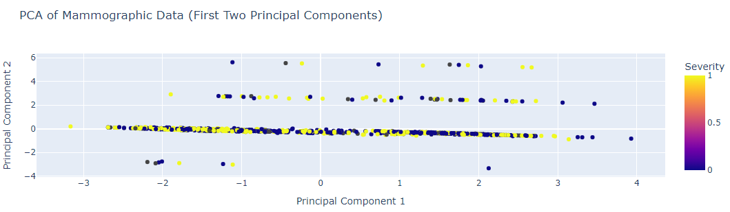
Task 4:​
We applied Sklearn's PCA algorithm on the dataset.

Slide 16
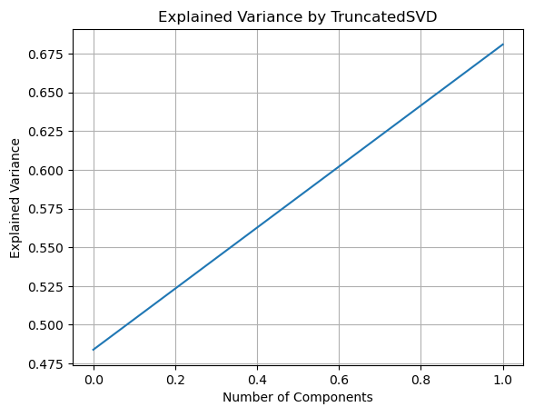
Task 4:​
We applied Sklearn's TSVD algorithm on the dataset.

Slide 17
Questions?

